Slide 1
Assignment1- (WEEK2-WEEK3)
ST, LT, Pool Table generation
Intermediate Code Generation

Slide 2
Assignment 1
Generate Symbol table, Literal table, Pool table & Intermediate code of a two-pass Assembler for the given source code

Slide 3
Tasks for WEEK 2
4 codes : (Check further slides for algorithm, data structure)
Generate Symbol Table (using EMOT, ST having 3 fields) and Print it.
(2) Generate Literal Table (using LC, no LTORG, only at END) (Note: 2 Fields of LT are String, Integer now, so convert =‘2’ to integer ‘2’ and store in LT now) and Print the LT.
(3) Generate Literal Table (Integer, integer) with Pool Table (LTORG) (You can assume that there are no duplicate literals in a Pool of literals) Print LT and Pool Table
(4) Merge above to Generate all 3 Tables- ST, LT and Pool Table

Slide 4
Sample Input File (W2-Task1) and Data structs (EMOT, ST)
Enhanced MOT
Mnemonic | Class | Opcode
STOP | 1 | 00
ADD | 1 | 01
SUB | 1 | 02
MULT | 1 | 03
MOVER | 1 | 04
MOVEM | 1 | 05
COMP | 1 | 06
BC | 1 | 07
DIV | 1 | 08
READ | 1 | 09
PRINT | 1 | 10
START | 3 | 01
END | 3 | 02
ORIGIIN | 3 | 03
EQU | 3 | 04
LTORG | 3 | 05
DS | 2 | 01
DC | 2 | 02
AREG | 4 | 01
BREG | 4 | 02
CREG | 4 | 03
EQ | 5 | 01
LT | 5 | 02
GT | 5 | 03
LE | 5 | 04
GE | 5 | 05
NE | 5 | 06
ANY | 5 | 07
Machine Opcode Table (MOT) ENHANCED
struct EMOTtable
{
char Mnemonic [6];
int Class;
char Opcode[3];
};
Struct EMOTtable MOT[28];
Symbol Table (ST)
struct symbol table
{
char Symbol[8];
int address;
int size; //ignore
}ST[20];
START 100
MOVER AREG, X
L1 ADD BREG, TEN
COMP BREG, TEN
BC EQ, LAST
ADD AREG, ONE
BC ANY, L1
LAST STOP
X DC ‘5’
TWO DC ‘2’
TEN DC ‘10’
END
Meaning of Class Field
Type | SYMBOL | VAL. OF CLASS FIELD
Imperative Statements | IS | 1
Declarative Statements | DL | 2
Assembler Directive | AD | 3
CPU Register | RG | 4
Conditional codes | CC | 5
sym | add | siz
L1 | 101 | 1
LAST | 106 | 1
X | 107 | 1
TWO | 108 | 1
TEN | 109 | 1

Slide 5
Algorithm- Symbol Table Generation (W2-Task1)
(Note: Only ST, Not handling literals/LTORG/END)
LC =0;
iST=0;
size=0; //initialize
Open Source code
While(!EOF)
Read nextline and store in char array “nextline”
If nextline is END, break;
Separate label, code and operand into S1,S2,S3/S4
If S1 is “START”, convert S2 to integer and initialize LC to that value.
If nextline has label, store in ST, along with current value of LC. S1 is Label if it is not in EMOT
If declarative statement (DC, DS) in “nextline” correctly Increment LC=LC+size //Size=1 if DC, and if DS, then Size=value ///at right of DS (S3)
g. If imperative statement (IS) in “nextline” Increment LC as below; size=1; LC=LC+size
7. Print Symbol Table
NOTE: SIZE Field in ST can be ignored in WEEK2 Assignment, but it has to be filled in WEEK 3

Slide 6
Sample Input/Output for W2-TASK 2
LITERAL TABLE (LT)
VALUE (String) | ADDRESS (integer)
=‘5’ | 209
=‘2’ | 210
=‘1’ | 211
=‘3’ | 212
START 200 MOVER AREG,=‘5’
MOVEM AREG,X
L1 MOVER BREG,=‘2’
NEXT ADD AREG,=‘1’
SUB BREG,=‘3’
BC LT, BACK
MULT CREG, X
STOP
X DS 1
END
(LC =200)
200
201
202
203
204
205
206
207
208
209
0
1
2
3
<-iLT

Slide 7
Algorithm – Generate Literal Table LT (W2-Task2)
(NOTE: This algorithm handles ONLY literals, at the END)
LC =0;
iLT=0;
size=0; //initialize
Open Source code
While(!EOF)
Read nextline and store in char array “nextline”
If nextline is END break;
Separate label, code and operand into S1,S2,S3 /S4
If S1 is “START”, initialize LC with integer value in S2
If declarative statement in “nextline” Increment LC=LC+size; //Size=1 if DC, //and if DS, then Size=value in S3
f. If “nextline” contains ‘=‘, then literal; add to literal table, and iLT++; size=1; Increment LC=LC + size;
g. if imperative statement without ‘=‘, LC=LC+1;
6. At “END” literals are handled
a. (Starting from first entry in Literal Table (LT), till end , give address to literals)
For ii=0 to <iLT do the following:
Enter LC into address field at ii;
size=1; LC=LC+size;
7. PRINT the LT.
NOTE: STRUCTURE of Literal Table (LT)
struct LiteralTab
{
char literal[6];
int address;
} LT[10];

Slide 8
Sample Input / Output for W2-TASK 3
LITERAL TABLE (LT)
VALUE (integer) | ADDRESS (integer)
5 | 203
2 | 204
1 | 208
2 | 209
START 200
MOVER AREG,=‘5’
MOVEM AREG,X
L1 MOVER BREG,=‘2’
LTORG
NEXT ADD AREG,=‘1’
SUB BREG,=‘2’
BC LT, BACK
LTORG
MULT CREG, X
STOP
X DS 1
END
(LC =200)
200
201
202
(LC=203)
(LC=204)
205
206
207
(LC=208)
(LC=209)
210
211
212
0
1
2
3
<-iLT
4
POOL TABLE
LITERAL NUMBER
0
2
0
1
<-iPT

Slide 9
Algorithm – Generate Literal Table LT, Pool Table (W2-Task3) NOTE : Change in structure of LITERAL TABLE below
(NOTE: This algorithm handles literals, LTORG, END)
LC =0;
size=1; //default value of size is 1
iPT=0; //pool table index
PT[iPT]=0;
iLT=0; //Index of Literal Table
LTplstart=-1; //Start index of pool in LT
Open Source code
While(!EOF)
Read nextline and store in char array “nextline”
If nextline is END break;
Separate label, code and operand into S1,S2,S3 /S4
If S1 is “START”, initialize LC with integer value in S2
If declarative statement in “nextline” Increment LC=LC+size (size=1 for DC) (if DS size= integer value of
f. If ‘=‘ found in “nextline”, then convert following (say ‘2’) into INTEGER and add to Literal Table; iLT++; Increment LC=LC + size(size=1)
g. If LTORG, then (Assign address to current pool of literals)
LTplstart=PT[iPT]; //Start of pool in LT
For ii= LTplstart to < iLT
Put in Address field at ii in LT val LC;
LC++;
iPT=iPT+1;
PT[iPT]=iLT; //Start of next pool
h. If EQU found, address in ST is corrected.
i. For imperative statements without literal do LC++;
9. At the “END” perform 8(g) TASK
10. Print LT, POOL table.
Literal Table (LT)
struct LiteralTab
{
int literal;
int address;
} LT[10];
Pool Table (PT)
int PT[10];

Slide 10
Sample Input / Output for W2-TASK 4
LITERAL TABLE (LT)
VALUE (integer) | ADDRESS (integer)
5 | 203
2 | 204
1 | 208
2 | 209
START 200
MOVER AREG,=‘5’
MOVEM AREG,X
L1 MOVER BREG,=‘2’
LTORG
NEXT ADD AREG,=‘1’
SUB BREG,=‘2’
BC LT, BACK
LTORG
MULT CREG, X
STOP
X DS 1
END
(LC =200)
200
201
202
(LC=203)
(LC=204)
205
206
207
(LC=208)
(LC=209)
210
211
212
0
1
2
3
<-iLT
4
POOL TABLE
LITERAL NUMBER
0
2
0
1
<-iPT
(ST)
SYMBOL(istring) | ADDRESS (integer)
L1 | 202
NEXT | 205
X | 212

Slide 11
Sample Input / Output for W2-TASK 4
SYMBOL TABLE (ST)
SYMBOL | ADDRESS
L1 | 202
NEXT | 207
BACK | 212/202
X | 215
0
1
START 200
MOVER AREG,=‘5’
MOVEM AREG,X
L1 MOVER BREG,=‘2’
ORIGIN L1+3
LTORG
NEXT ADD AREG,=‘1’
SUB BREG,=‘2’
BC LT, BACK
LTORG
BACK EQU L1
ORIGIN NEXT+9
MULT CREG, X
STOP
X DS 1
END
(LC =200)
200
201
202
(LC=205)
(LC=205)
(LC=206)
207
208
209
(LC=210)
(LC=211)
212
(LC=216)
216
217
218
2
3
<-iST
LITERAL TABLE (LT)
VALUE | ADDRESS
=‘5’ | 205
=‘2’ | 206
=‘1’ | 210
=‘2’ | 211
0
1
2
3
<-iLT
POOL TABLE
LITERAL NUMBER
0
2
0
1
<-iPT

Slide 12
Algorithm – Generate ST, Literal Table LT, Pool Table (W2-Task4) - Combined Algorithms of TASK1 and TASK3, plus ORIGIN, EQU
(NOTE: This algorithm handles Symbols, literals, LTORG, ORIGIN, EQU)
LC =0;
size=1; //default value of size is 1
iST=0; //Symbol table index
iPT=0; //pool table index
PT[iPT]=0;
iLT=0; //Index of Literal Table
LTindex=-1; //Start index of pool in LT
Open Source code
While(!EOF)
Read nextline and store in char array “nextline”
If nextline is END break;
Separate label, code and operand into S1,S2,S3 /S4
If S1 is “START” or “ORIGIN”, initialize LC with integer value in S2
If nextline has label, store in ST, along with current value of LC.;iST++; (S1 is Label if it is not in EMOT)
If declarative statement in “nextline” Increment LC=LC+size
If imperative statement (IS) in “nextline” Increment LC as below; size=1; LC=LC+size
h. If ‘=‘ found in “nextline”, then convert following (say ‘2’) into INTEGER and add to Literal Table; iLT++;
i. If LTORG, then (Assign address to current pool of literals)
LTindex=PT[iPT];
For ii= LTindex to < iLT
Address field at ii in LT = LC;
LC++;
iPT=iPT+1;
PT[iPT]=iLT; //Start of next pool
j. If EQU found, address in ST is corrected.
10. At the “END” perform 9(i) TASK
11. Print ST, LT, POOL table.

Slide 13
Task – WEEK3
For the given input file generate Intermediate Code in a file and print it
(Sample in next slide)

Slide 14
Intermediate Code (IC) table
struct intermediatecode
{
int LC;
int code1,type1; //code1=index in MOT,type1= 1/2/3
int code2,type2; //Similar for 2nd symbol
int code3,type3; //Similar for 3rd symbol
} IC[30];

Slide 15
Intermediate Code (IC) table
struct intermediatecode
{
int LC;
int code1,type1; //code1=index in MOT,type1= 1/2/3
int code2,type2; //Similar for 2nd symbol
int code3,type3; //Similar for 3rd symbol
} IC[30];

Slide 16
Sample Input File (W2-Task1) and Data structs (EMOT, ST)
Enhanced MOT
Mnemonic | Class | Opcode
STOP | 1 | 00
ADD | 1 | 01
SUB | 1 | 02
MULT | 1 | 03
MOVER | 1 | 04
MOVEM | 1 | 05
COMP | 1 | 06
BC | 1 | 07
DIV | 1 | 08
READ | 1 | 09
PRINT | 1 | 10
START | 3 | 01
END | 3 | 02
ORIGIIN | 3 | 03
EQU | 3 | 04
LTORG | 3 | 05
DS | 2 | 01
DC | 2 | 02
AREG | 4 | 01
BREG | 4 | 02
CREG | 4 | 03
EQ | 5 | 01
LT | 5 | 02
GT | 5 | 03
LE | 5 | 04
GE | 5 | 05
NE | 5 | 06
ANY | 5 | 07
Machine Opcode Table (MOT) ENHANCED
struct EMOTtable
{
char Mnemonic [6];
int Class;
char Opcode[3];
};
Struct EMOTtable MOT[28];
Symbol Table (ST)
struct symbol table
{
char Symbol[8];
int address;
int size; //ignore
}ST[20];
START 100
MOVER AREG, X
L1 ADD BREG, TEN
COMP BREG, TEN
BC EQ, LAST
ADD AREG, ONE
BC ANY, L1
LAST STOP
X DC ‘5’
TWO DC ‘2’
TEN DC ‘10’
END
Meaning of Class Field
Type | SYMBOL | VAL. OF CLASS FIELD
Imperative Statements | IS | 1
Declarative Statements | DL | 2
Assembler Directive | AD | 3
CPU Register | RG | 4
Conditional codes | CC | 5

Slide 17
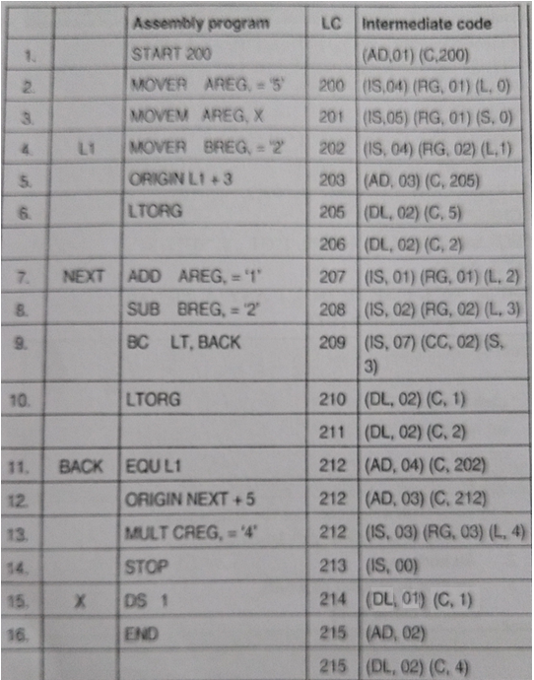
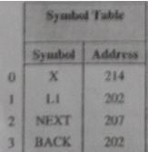
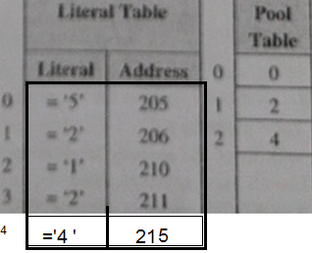

Slide 18
Thank you!!

